Slide 1
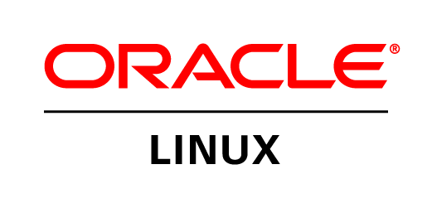

Oracle Linux Overview
Wim Coekaerts
Sr Vice President Linux and Virtualization engineering
Notes:
This is the SHORT version of the Oracle Linux Overview customer pitch

Slide 2
Safe Harbor Statement
The following is intended to outline our general product direction. It is intended for information purposes only, and may not be incorporated into any contract. It is not a commitment to deliver any material, code, or functionality, and should not be relied upon in making purchasing decisions.
The development, release, and timing of any features or functionality described for Oracle’s products remains at the sole discretion of Oracle.
Notes:
2

Slide 3

Agenda
Oracle Linux Strategy
Overview and Roadmap
Support & Pricing
Why Oracle Linux?
Next Steps

Slide 4
Why is Linux Important to Oracle
Because Linux is important to our customers
Initially all about taking advantage of commodity systems
Now its about real production application workloads
Oracle Engineered systems are built using Oracle Linux

Slide 5

Oracle Linux: The Best Linux for the Enterprise
Featuring the Unbreakable Enterprise Kernel
Compatible with Red Hat Enterprise Linux
Free source code, binaries and patches
Runs in Oracle’s Engineered Systems
Oracle’s base Linux development platform
The only Linux Oracle recommends for Oracle software
Notes:
Enterprise Linux distribution
Free source code and binaries, free to distribute
Now even free patches and security updates
Oracle’s base Linux development platform
Fully compatible with Red Hat Enterprise Linux enabling customers can switch in minutes
No reinstall needed; applications run unchanged

Slide 6
Comprehensive Linux Solution
Dedicated development team
Dedicated QA team
Dedicated support team
Dedicated ISV and IHV team
Oracle Linux training and certification
Oracle Linux consulting services

Slide 7
Nearly 15 years of investments in Linux
7,000 Oracle Linux support customers
Oracle buys Ksplice
DTrace porting begins
2010
2011
2006
Oracle Linux enhanced with mainline-based kernel
Oracle Linux undergoes 80,000 QA hours per day
Exadata engineered with Oracle Linux
Oracle Linux Support announced
Oracle joins Linux Foundation as board member
2002
Linux History
at Oracle
Launch of Unbreakable Linux
Asynch I/O, OCFS v1
1998
First Commercial
RDBMS for Linux
2005
2008/2009
On Demand Adopts x64 Linux
OCFS2 accepted into mainline
9,000 Developers switch to Oracle supported Linux
Btrfs, Xen contributions
42,000 Oracle Linux servers deployed at Oracle
2000
Cloud Computing
First x64 Linux Port
2012
2007
Data Warehouse
Support lifecycle extended to 10 yrs
Linux Datacenter
Workloads
Validated Configurations launched
General Purpose ERP/CRM
Development Systems
Single Use Production Deployments
1998
2000
2002
2004
2006
2008
2010
2012
Notes:
Oracle is #1 IT company running Linux
Low cost, high performance
Standard
Liberating Intel from Windows
Making Linux safe and secure
Making it more scalable and faster
Open source contributions
Oracle is #1 IT company running Linux
First commercial database for Linux (1998)
Adopts Apache Web Server (1999)
Adopts SOAP (2001)
Joins Eclipse.org (2002)
Partners with Zend for PHP support (2005)
Supports Glassfish (2005)
Purchases InnoDB (2005)
Purchases Sleepycat (creator of Berkeley DB) (2006)
Subversion plug-in for Jdeveloper jointly developed with Collabnet (2006)
Launch of Unbreakable Linux (2006)
Open sources Toplink Essentials (2007)
Open sources XQilla Xquery/Xpath (2007)

Slide 8















































More Than 8,900 Customers…and Growing
Rely on Oracle Linux Support
Notes:
UBL Customers http://www.oracle.com/us/technologies/linux/025990.htm
OVM Customers http://www.oracle.com/us/technologies/virtualization/024937.htm

Slide 9



















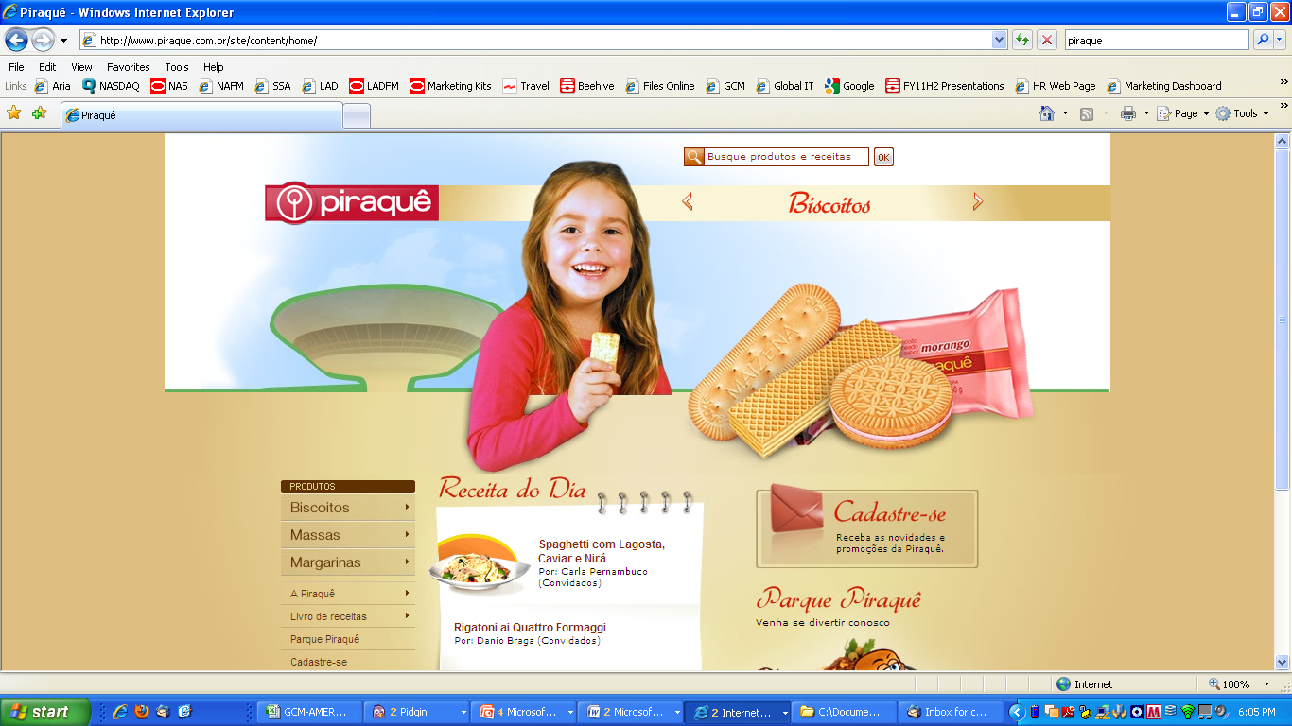






Exadata Customers running Oracle Linux

Slide 10
“BT has decided that Linux is the way forward for all our major applications. BT chose Oracle Linux over Red Hat Enterprise Linux. We have hundreds of servers continually growing with Oracle Linux installed. So any new services that use Linux that will be built -- any of the new servers -- will have Oracle Linux installed on it.”
Surren Partabh
Chief Technology Officer, British Telecom

Slide 11
Leading ISVs Support Oracle Linux
Adobe
Autonomy
BMC
CA
CommVault
EMC
Informatica
Infor
Progress Software
Quest
SAP
Sungard
Symantec
Tibco
150% YoY growth in the no. of apps supported on Oracle Linux

Slide 12
Oracle Linux Strategy
Bringing the Latest Linux Innovations to Customers
The best performing, most modern and reliable Linux OS
Track mainline closely
Influence Linux roadmap upstream via direct code contributions
Highest value, enterprise-class support
Deployment best practices: full stack tested with real-world workloads
Lower cost
Comprehensive legal indemnification

Slide 13
Oracle Linux: The True Enterprise Linux
Developed by the world's leading enterprise computing company
  Engineered together with servers, storage, database, middleware, apps
Tested continuously in large test farms
  Oracle's base development environment for almost all Oracle products
  128,000 compute hours/day testing Oracle products on Oracle Linux
  Nearly 40,000 Linux systems in QA farm
Supported by Linux experts who also have deep knowledge of Oracle's entire stack
  Fixes available for version customers run
The result of a decade of enterprise focused Linux innovation
Bringing the mission-critical Unix support experience to Linux

Slide 14
Oracle Linux: Fast, Modern, Reliable
Fast
  Leading benchmarked performance
  Parallelized network and disk I/O
Modern
  Mainline-based Linux kernel
  Btrfs — the future default Linux file system
  Optimized for solid state disk
Reliable
  Tested with Oracle software
  Built in data integrity
  Hardware fault management
  Zero downtime kernel updates
  Roll back updates
Notes:
Design goals for Oracle Linux
Best possible performance we can deliver
Able to get the most our of modern hardware
- it's able to parallelize network and disk IO
- efficiently runs on systems with many cores and threads and NUMA nodes
- does the right thing when it's dealing with solid state storage vs spinning disks which is to say, skip 20 years worth of optimizations that are in the kernel to
Reliable
- Tested with real world workloads
- backed by a support offering that's modeled on traditional UNIX support
- comes with hardware fault management and advanced data integrity features
- with Ksplice you can apply kernel updates without having to schedule maintenance windows and without taking down your applications
o and you can roll back those kernel updates
- if you're using Btrfs, you can even roll back package updates you do on disk

Slide 15
Oracle Linux Overview
Unbreakable Enterprise Kernel is the default kernel
Red Hat Compatible Kernel is also available
Support pricing is same regardless of the kernel used
Oracle recommends using the Unbreakable Enterprise Kernel

Slide 16
NEW: Unbreakable Enterprise Kernel Release 2
Based on mainline 3.0.stable tree Linux kernel
Even faster at scale
  Improved scheduler for high thread count applications
  Transmit packet steering across CPUs for lower latency
  Transparent huge pages for memory intensive workloads
Btrfs
Linux Containers
  Low overhead O/S isolation and resource management
Virtual Switch
  VLAN isolation, filtering, QoS, monitoring, automated control
DTrace
  Comprehensive dynamic tracing framework

Slide 17
Faster at Scale – Benchmarks
TPC-C Results (Million tpmC)
Notes:
Sun Fire X4800 M2 running Oracle Linux with UEK R.2 better than 64 CPU HP Superdome
Nearly 3x better price per TPC-C transaction
First x86 system to achieve over 4 million tpmC
4.8mln tpmC @ $0.98/tpmC
Sun x4800 M2 + Oracle Linux & UEK R2
8 CPUs —Intel Xeon E7-8870
160 threads
4 TB RAM

Slide 18
Oracle Linux: Open
Oracle Linux is free to download, use and distribute
  Only pay when you use support
Free Oracle Linux binaries, updates and errata
No subscriptions required for Oracle Linux systems not covered by support
Publicly accessible yum server for all Oracle Linux installation media content
Public git repository for Unbreakable Enterprise Kernel containing complete history of kernel development
  http://oss.oracle.com/git

Slide 19
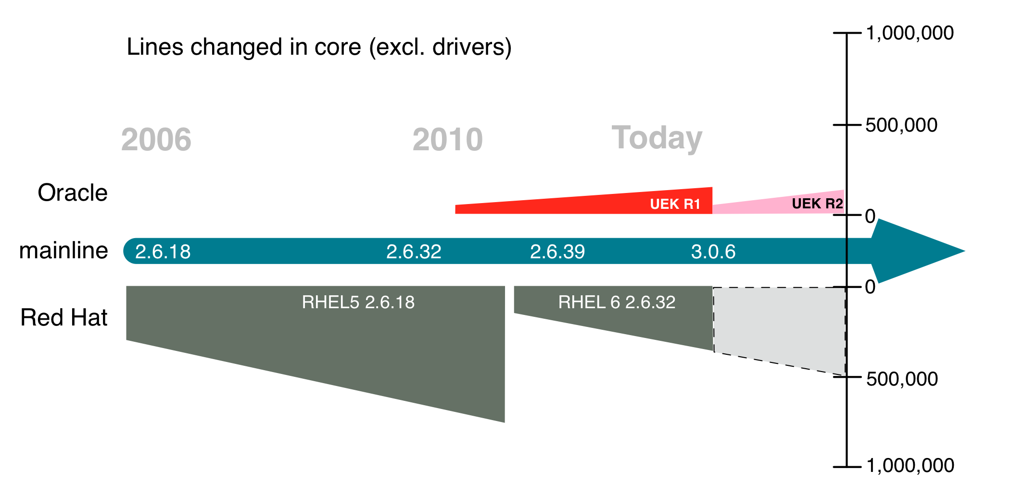
Unbreakable Enterprise Kernel: Tracking Mainline
Better able to deliver
  features
  performance
  hardware support
Ship code that Linux community works on and not a unique fork
Less labor intensive
Benefit from free testing taking place in the community
Notes:
• SuSE has validated this strategy as well with SLES11 SP2
* Greg KH is a big proponent (Linux foundation fellow)
* http://lwn.net/Articles/486304/

Slide 20
Oracle’s Linux Contributions
Oracle is a Platinum member of the Linux Foundation
Wim Coekaerts is a Linux Foundation board member
Several key contributors (including maintainers) at Oracle
  OCFS2
  Storage
  NFS
  Btrfs
  SELinux
  RDS
  Xen hypervisor interface
  Networking IPv4/IPv6
  JFS
Several security@kernel.org security officers work on the Oracle Linux team

Slide 21
Linux Contributions
ALL Linux kernel enhancements made by Oracle for the Unbreakable Enterprise Kernel are open source and have been made available to the Linux community; including change logs, commit messages
http://oss.oracle.com/git/?p=linux-2.6-unbreakable.git

Slide 22


Zero Downtime Updates with Ksplice
  Ksplice lets you install important kernel updates with:
    No downtime
    No disruption
    No rebooting
    While applications are running
  Only Oracle Linux offers this capability
Ksplice Zero Downtime Updates Available to Oracle Linux Premier Support Customers; No additional Cost

Slide 23
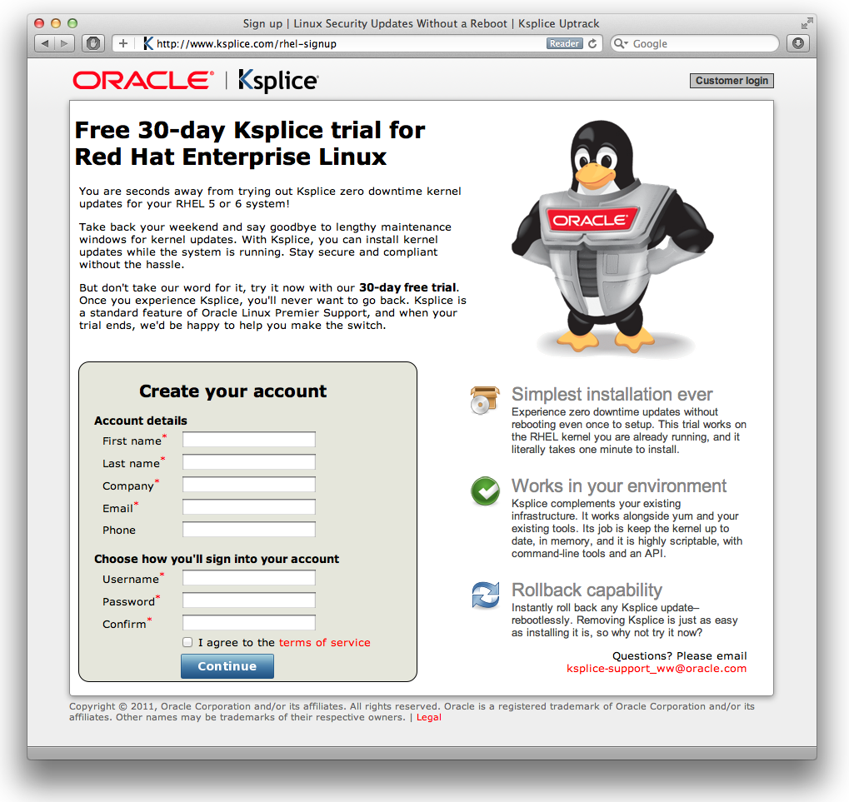
NEW: Ksplice 30 Day Free Trial for RHEL
Available to any with RHEL 5 or RHEL 6 user
Simple registration
One minute installation of Uptrack client

Slide 24

Linux Management and Clustering
Integrated Apps to Disk Management and HA
Oracle Ops Center and Enterprise Manager 12c for Linux Management
Administration
Patching
Provisioning
Oracle Clusterware: Linux High Availability
Business continuity
Protects from failure
Included free with:
Oracle Linux Basic support
Oracle Linux Premier support
24
Notes:
Cluster software groups individual servers to cooperate as a single system:
Enables high availability and business continuity;
Helps ensure the protection of an application, Oracle or third-party;
Included with Oracle Linux Basic and Premier support levels at no additional charge

Slide 25
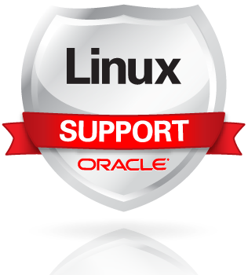
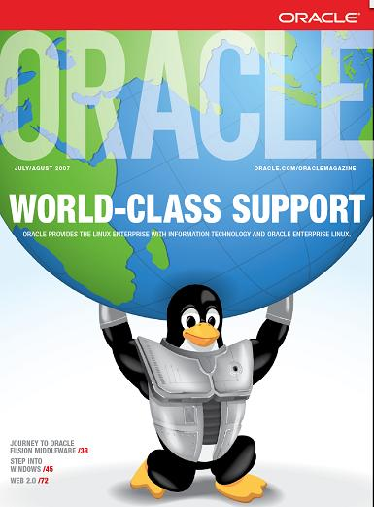
Enterprise-Class Linux Support
24x7 global coverage, 145 countries, 29 local languages
Dedicated engineering and delivery team
World’s largest support team
Real-world testing
Lower cost
Included with Oracle Premier Support for Systems and OS
Notes:
Oracle Linux leverages Oracle’s world-class support infrastructure to offer 24/7 Linux support in 145 countries worldwide. Oracle delivers highest quality, enterprise-class, low-cost support for Linux with:
Zero downtime kernel updates for customers with Oracle Linux Premier Support
Premier backports
Management and clustering software at no additional charge
Comprehensive legal indemnification (Top 5 Facts About Oracle’s Indemnification for Linux)
Full-stack testing and best practices with Oracle Validated Configurations
Lower cost than Red Hat or other competitors
When you purchase Oracle’s Sun x86 Systems with Premier Support for Systems, Oracle Linux Premier Support is included (as well as support for Oracle VM and Oracle Solaris). No need to pay or install additional Linux software.

Slide 26
Premier Backports
Premier Backports allow customers to upgrade on their own schedule while still getting bug fixes
No forced upgrades
Modeled after the way we support traditional Oracle products
Provided for packages up to six months after a newer version of that package has been released
Example:
  A bug is reported by customer against 2.6.18-238.36.2
  Latest kernel version is 2.6.18-299.1.1
  Oracle support provides kernel 2.6.18-238.36.3: the same kernel the customer was running on, with the fix for the problem they hit

Slide 27

Focus on Linux Testing
Dedicated Linux QA team
Real-world regression and stress testing
Customer-centric testing:
  Test Linux features that matter to Oracle customers
  Oracle and non-Oracle workloads (e.g. backup) running concurrently
  Adverse conditions (low memory, low disk space, etc.)
  Long, continuously running stress tests (detect memory leaks)
  Check for performance regression and degradation
Notes:
We have worked with Oracle customers on Linux for many years working through issues so we have a good idea of the kinds of configurations and cases that matter to them.

Slide 28

Best Practices: Oracle Validated Configurations
Pre-tested, validated
Software, hardware, storage, drivers, networking
Real-world testing of complete stack
More than 150 configurations published
Freely available for download
Oracle Database
Fusion Middleware
Oracle Linux
Oracle VM
Server
Storage
Accelerate Linux deployments, lower infrastructure costs
Notes:
Speed successful deployment of Linux
Reduce expensive testing
Achieve faster time to market
Lower infrastructure costs
Improve performance, scalability, reliability
Mitigate risk

Slide 29


Support & Pricing Comparison
Red Hat Enterprise Linux Server Premium*
Oracle Linux Premier
Access to Updates and Patches
24x7 Phone and Web support
No Forced Upgrades to Obtain Bug Fixes
Lifetime Support
Integrated Management and Monitoring
Clustering Software and File System
Zero Downtime Updates with Ksplice
Comprehensive Legal Indemnification
Pricing
$6,498
$2,299
(2 X $3,249 per socket pair)
** No add-ons; Pricing based on 4 socket comparison and 1 year term, Oracle pricing based on Oracle Linux Premier

Slide 30
Summary: Why Switch to Oracle Linux
Reason | Details
Free to download and distribute | Oracle Linux binaries and patches
Lower cost to deploy in production | Affordable support Free enterprise-class management and clustering tools Oracle Linux support included with Oracle’s Sun x86 systems support at no additional fees
Zero-downtime kernel updates with Ksplice | Only Oracle offers this Available to all Premier Support customers at no additional charge
Higher quality support; faster problem resolution | Premier backports Support experts understand not just the OS but also the apps and databases running on Linux Single point of support from Apps to Disk
Ease of deployment | Oracle Validated Configurations for Linux Oracle VM Templates
Oracle Linux tracks the mainline kernel closely | Fast, Modern and Reliable Take advantage of the latest Linux innovations

Slide 31
Switching to Oracle Linux
Existing Red Hat customers do not need to re-install Linux
Switch to Oracle Linux in just minutes
Step
1
Step
2
Step
3
Done
  Purchase support or use the Public Yum
  Register for
  ULN account via linux.oracle.com/register
  Download and install ULN then register your system
  You start getting your Linux updates from Oracle!
31
Notes:
For existing Red Hat customers switching to Oracle Linux support needs only minutes not hours. You also don’t need to re-install software. All you need is the a ULN account which will be available once you purchase Oracle Linux support. Download registration program and them download the updates via up2date or yum.
Purchase support
Register for ULN account via linux.oracle.com/register
Download Oracle’s registration program – linux.oracle.com
Run uln_register to register your server
Server can now download updates built by Oracle via up2date or yum

Slide 32

Next Steps
Linux Home Page
oracle.com/linux
Follow us on Twitter
  twitter.com/ORCL_Linux
Become a fan on Facebook
  Facebook.com/OracleLinux
Subscribe to our channel YouTube
  YouTube.com/OracleLinuxChannel
Free Download: Oracle Linux
edelivery.oracle.com/linux
Notes:
32

Slide 33
Q&A

