Slide 1


Oracle Linux Overview
Monica Kumar, Senior Director, Product Marketing
November 2011

Slide 2
Safe Harbor Statement
The following is intended to outline our general product direction. It is intended for information purposes only, and may not be incorporated into any contract. It is not a commitment to deliver any material, code, or functionality, and should not be relied upon in making purchasing decisions.
The development, release, and timing of any features or functionality described for Oracle’s products remains at the sole discretion of Oracle.
Notes:
2

Slide 3

Agenda
Oracle Linux Strategy
Product Overview
Product Roadmap
Support & Pricing
Next Steps

Slide 4
Oracle Linux
Launched at Oracle OpenWorld in 2006
Enterprise Linux distribution
Free source code and binaries, free to distribute
Low cost, affordable support subscription
Oracle’s base Linux development platform
Fully compatible with Red Hat Enterprise Linux enabling customers can switch in minutes – no reinstall needed; applications run unchanged

Slide 5
Comprehensive Linux Solution
Dedicated development team
Dedicated QA team
Dedicated support team
Dedicated ISV and IHV team
Oracle Linux training and certification
Oracle Linux consulting services

Slide 6
Oracle Linux Strategy
Bringing the Latest Linux Innovations to Customers
The best performing, most modern and reliable Linux OS
Track mainline closely
Influence Linux roadmap upstream via direct code contributions
Highest value, enterprise-class support
Deployment best practices: full stack tested with real-world workloads
Lower cost
Comprehensive legal indemnification

Slide 7
45,000+ SERVERS IN ORACLE GLOBAL IT RUN ORACLE LINUX
DATA INTEGRITY
BEST PRACTICES
PREMIER BACKPORTS
#1 LINUX DATABASE
EXALOGIC
LOWER COST
KSPLICE ZERO DOWNTIME UPDATES
MANAGEMENT
COMMUNITY CONTRIBUTIONS
ORACLE DRIVES LINUX INNOVATION
BTRFS
FAST, MODERN, RELIABLE LINUX
EXADATA
20,000+ DEVELOPERS AT ORACLE USE OARCLE LINUX
CLUSTERING
UNBREAKABLE ENTERPRISE KERNEL
ORACLE VALIDATED CONFIGURATIONS
SYSTEM & OS FROM SAME VENDOR
GLOBAL ENTERPRISE-CLASS SUPPORT IN 145 COUNTRIES
Notes:
The key point I’d like to get across today is that Oracle Drives Linux Innovation
7

Slide 8















































More Than 8,000 Customers…and Growing
Rely on Oracle Linux Support
Notes:
UBL Customers http://www.oracle.com/us/technologies/linux/025990.htm
OVM Customers http://www.oracle.com/us/technologies/virtualization/024937.htm

Slide 9



















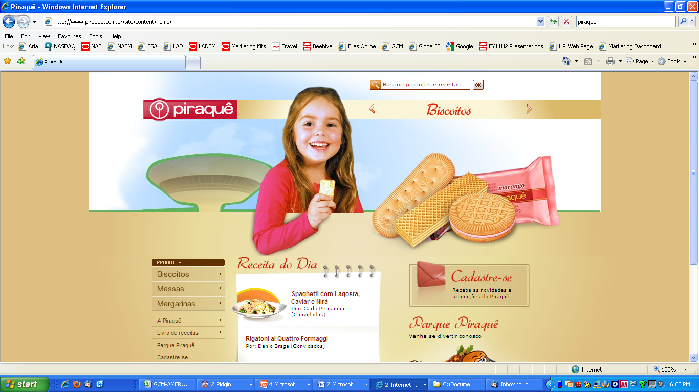






Exadata Customers running Oracle Linux

Slide 10
“BT has decided that Linux is the way forward for all our major applications. BT chose Oracle Linux over Red Hat Enterprise Linux. We have hundreds of servers continually growing with Oracle Linux installed. So any new services that use Linux that will be built -- any of the new servers -- will have Oracle Linux installed on it.”
Surren Partabh
Chief Technology Officer, British Telecom

Slide 11
Leading ISVs Support Oracle Linux
Adobe
Autonomy
BMC
CA
CommVault
EMC
Informatica
Infor
Progress Software
Quest
SAP
Sungard
Symantec
Tibco

Slide 12

Mismatch in Expectations
Traditional Unix Vendor | Traditional Linux Vendor
Develops and tests hardware and OS together | Develops OS only
Oracle knowledge in development, QA, and support | No Oracle expertise, staff
Tests entire Oracle stack (hardware, OS, and Oracle Database) | Limited testing of OS only
Provides fixes for OS version customer runs | Customer encouraged to upgrade to latest release plus fix
Notes:
If you compare the way traditional UNIX is developed, tested and supported against how Linux is developed by today’s Linux vendors, you see the following picture emerge:
A traditional UNIX vendor, for example, Sun (now Oracle) or HP develops and tests server hardware and the OS together
Whereas a Linux vendor such as RHAT only develops the OS
Let’s look at Oracle expertise. Before IBM comes out with a new release of AIX, they first test it with the Oracle database. They have developers and QA engineers on staff that have deep knowledge of Oracle products.
Contrast that with a Linux-only vendor such as Red Hat, and you’ll find that there is no real Oracle expertise and nobody to consider what happens when you run the Oracle database on the latest release they’re pushing out
So a traditional UNIX vendor will test an entire stack of hardware, OS and Oracle database whereas a Linux-only vendor will do limited operating system testing only
The last distinction is an important one. When a traditional UNIX customer runs into a bug, the UNIX vendor will provide them with a fix in the version of the OS that they are running.
A Linux vendor, in most cases, will encourage the customer to upgrade to a newer release. That new release will have the fix the customer needs, but it will also have dozens if not hundreds of other changes that will have to be tested before deploying to production.
With Oracle Linux support, our goal is to bring Linux support up to the level of quality that users have come to expect from traditional UNIX support. This means that our developers and support staff have knowledge of both Linux and Oracle, that we test Linux running with Oracle on top of it. But also, that, under our premier support offering, we provide backports of fixes to the version of Linux you are running. We will not make unreasonable requests for you to upgrade.
So, two big distinctions between traditional UNIX support and Linux support are 1) The way the OS is tested; and 2) The way bugs are fixed in a customer’s environment.
Let’s take a close look at how Oracle approaches testing

Slide 13
ORACLE BRINGS THE PROVEN UNIX MODEL TO LINUX
Notes:
13

Slide 14

Oracle Linux
Fast, Modern, Reliable and Optimized
Notes:
14

Slide 15
Oracle Linux Overview
Unbreakable Enterprise Kernel is the default kernel with Oracle Linux
  Open source and free to download
Red Hat Compatible Kernel is also available
Latest release is Oracle Linux 6.1
Support pricing is same regardless of which kernel you use
Oracle recommends using the Unbreakable Enterprise Kernel

Slide 16
The Unbreakable Enterprise Kernel
Fast, modern, reliable
Used by Exadata and Exalogic for extreme performance
Brings the latest Linux innovations to customers
Release 1 is based on kernel 2.6.32
  Plus brand new optimizations from Oracle that are all open source
Available in both Oracle Linux 5 and Oracle Linux 6
Existing applications run unchanged
Notes:
If you look at RHEL 5, which is supported until at least 2014 it comes with a kernel that is effectively 4 years old. Four years represents a lot of innovation and development in Linux and we were looking for a way to bring modern features and performance to customers.
With UEK we can do that without asking customers to upgrade to a new OS. UEK is now part of Oracle Linux 5. For customer who are ready to move to Oracle Linux 6, that has UEK as well. In both cases, customers have a choice: boot a kernel optimized for running Oracle software or a Red Hat compatible kernel
Unbreakable Enterprise Kernel is now the kernel we use for all our development and testing of Oracle software and therefore, it’s the kernel we recommend to all of our customers.

Slide 17
The Unbreakable Enterprise Kernel: Modern
Bigger servers
  Up to 4096 CPUs and 2 TB of memory
  Up to 4 PB (petabyte) clustered volumes with OCFS2
  Advanced NUMA support
Power management
  CPUs to stay in low power state when the system is idle
Fine grained CPU and memory resource control

Slide 18
The Unbreakable Enterprise Kernel: Reliable
Data Integrity: Eliminates silent data corruption using T10 spec; stops corrupt data from being written
Hardware Fault Management: Reduces system crashes and improves system uptime
Diagnostics Tools: Improved tools
The Unbreakable Enterprise Kernel tracks mainline Linux – users get community and Oracle enhancements faster

Slide 19
Ongoing Contributions to Linux Kernel
Btrfs
Data integrity T-10
Xen
OCFS2
FedFS
Transcendent Memory
Infiniband and RDS

Slide 20
Linux Contributions
ALL Linux kernel enhancements made by Oracle for the Unbreakable Enterprise Kernel are open source and have been made available to the Linux community; including change logs, commit messages
http://oss.oracle.com/git/?p=linux-2.6-unbreakable.git

Slide 21

Zero Downtime Updates
Notes:
21

Slide 22




Traditional Update Approach
Disruptive, Downtime and Delays
Security Update Released
…One Week Later
…And Another 4 Hours Later
System administrator negotiates with management to schedule outage windows
System administrator schedules downtime the following week
System administrator notifies users of planned downtime
Shut down application server
Shut down database
Apply Linux OS update
Start up database
Start up application server
Sanity check application
Updates applied and tested
Back in business after first notification of security update - typically over one week has passed
Notes:
22

Slide 23

We Solve This Problem in Oracle Linux!
Zero Downtime Updates with Ksplice
  Ksplice lets you install important kernel updates with:
    No downtime
    No disruption
    No rebooting
    While applications are running
  Only Oracle Linux offers this capability
Ksplice Zero Downtime Updates Now Available to Oracle Linux Premier Support Customers; No additional Cost

Slide 24




Ksplice Available for Oracle Premier Support Customers
Ksplice transforms Oracle Linux updates into zero downtime updates
Linux servers within the customer environment connect to a Unbreakable Linux Network to download and apply updates while the system is running
Customers can track the status of their servers via an intuitive web interface and can integrate zero downtime updates into existing management tools via an API
Client
Kernel update
Ksplice technology
Zero downtime
kernel update
Customer systems
Notes:
24

Slide 25
Oracle Linux
Integrated, Optimized, More Tools
Notes:
25

Slide 26
Oracle Management Pack for Linux
Integrated Apps to Disk Management
Included free with Oracle Linux Basic and Premier support levels
Linux server management features :
  Remote Administration
  Configuration Management
  Linux Patching
  Bare Metal OS Provisioning
  Cloud Control Integration
  OS Performance Monitoring
  Policy Management
Notes:
Provide remote administration capabilities for hosts.
Provide hardware and software configuration data collection, search, comparison, and analytical reporting.
Provide automated host patching and integration with an Unbreakable Linux network (ULN).
Automate Kickstart, Jumpstart, YAST, and DHCP configuration for the remote light-out provisioning of servers. Create profiles to capture finish scripts and customization.
Provide integration between Enterprise Manager Cloud Control and Ops Center. Discover targets and view alarm information. View hardware, OS, and virtualization information.
Provide Oracle Solaris and Linux OS performance monitoring, both real-time status of attributes and historical charting.
Ensure consistency of deployments and adherence to operation standards. Includes policy violation notifications.

Slide 27
Oracle Clusterware
High Availability
Cluster software groups individual servers to cooperate as a single system:
  Enables high availability and business continuity;
  Helps ensure the protection of an application, Oracle or third-party;
Included with Oracle Linux Basic and Premier support levels at no additional charge

Slide 28
Oracle Database Smart Flash Cache
Integration with Oracle Linux
Feature of Oracle Database 11g Release 2
Increases the size of the database buffer cache without having to add RAM to the system
Available flash memory acts as second level database buffer cache
Improves performance by eliminating physical disk reads, especially for read intensive application
Only available on Oracle Linux and Oracle Solaris

Slide 29
Oracle Linux Roadmap
Releases and Focus Areas
Notes:
29

Slide 30
Innovating Linux: Unbreakable Enterprise Kernel
Release 2 Beta Now Available
UEK roadmap: 12-18 month refresh
UEK R2 based on mainline Linux kernel 2.6.39
Faster, better, more stable than 2.6.32
Better for database and middleware
Optimized for both small and large systems
Unbreakable Enterprise Kernel is the default kernel in Oracle Linux, and is recommended by Oracle

Slide 31
Innovating Linux
Upcoming Features; Better Linux for All
DTrace
Transcendent memory via cleancache
Modern, Advanced file system: Btrfs
Data integrity from “Applications to Disk”
Resource isolation – cgroups
OS isolation – Linux Containers
Built in virtual switch

Slide 32
Oracle Linux Support
Enterprise-Class, Global, 24x7 Linux Support
Notes:
32

Slide 33


Oracle Linux Support
Enterprise-class support for Linux operating system with zero downtime kernel updates, premier back ports, comprehensive management and clustering tools, legal indemnification, testing and more – all at significantly lower cost.
24x7 global coverage, 145 countries, 29 local languages
Dedicated engineering and delivery team
Backed by world’s largest support team
Real-world testing; Validated Linux
Lower cost
Included with Oracle Premier Support for Systems & Operating Systems
Continuous operational improvement
Accelerate return on IT investment
Reduce cost, risk, and complexity

Slide 34
Premier Backports
Premier Backports allow customers to upgrade on their own schedule while still getting bug fixes
No forced upgrades
Modeled after the way we support traditional Oracle products
Provided for packages up to six months after a newer version of that package has been released
Example:
  A bug is reported by customer against 2.6.18-238.36.2
  Latest kernel version is 2.6.18-299.1.1
  Oracle support provides kernel 2.6.18-238.36.3: the same kernel the customer was running on, with the fix for the problem they hit

Slide 35
Focus on Linux Testing
Dedicated Linux QA team
Real-world regression and stress testing
Customer-centric testing:
  Test Linux features that matter to Oracle customers
  Oracle and non-Oracle workloads (e.g. backup) running concurrently
  Adverse conditions (low memory, low disk space, etc.)
  Long, continuously running stress tests (detect memory leaks)
  Check for performance regression and degradation
Notes:
We have worked with Oracle customers on Linux for many years working through issues so we have a good idea of the kinds of configurations and cases that matter to them.

Slide 36

Best Practices: Oracle Validated Configurations
Pre-tested, validated, and supported Linux architectures, including
Software, hardware, storage, drivers, networking components
Best practices for Linux deployment
Real-world testing of complete stack
More than 150 configurations published, freely available for download
oracle.com/linux
Oracle Database
Fusion Middleware
Oracle Linux
Oracle VM
Server
Storage
Oracle Validated Configurations offer faster Linux deployments while lowering infrastructure costs
Notes:
Speed successful deployment of Linux
Reduce expensive testing
Achieve faster time to market
Lower infrastructure costs
Improve performance, scalability, reliability
Mitigate risk

Slide 37


Support & Pricing Comparison
Red Hat Enterprise Linux Server Premium*
Oracle Linux Premier
Access to Updates and Patches
24x7 Phone and Web support
No Forced Upgrades to Obtain Bug Fixes
Lifetime Support
Integrated Management and Monitoring
Clustering Software and File System
Zero Downtime Updates with Ksplice
Comprehensive Legal Indemnification
Pricing
$6,498
$2,299
(2 X $3,249 per socket pair)
** No add-ons; Pricing based on 4 socket comparison and 1 year term, Oracle pricing based on Oracle Linux Premier

Slide 38
Switching to Oracle Linux Support
Existing Red Hat customers do not need to re-install Linux
Switch to Oracle Linux support in just minutes
  Purchase support
  Register for ULN account via linux.oracle.com/register
  Download Oracle’s registration program – linux.oracle.com
  Run uln_register to register your server
  Server can now download updates built by Oracle via up2date or yum

Slide 39

Next Steps
Linux Home Page
oracle.com/linux
Follow us on Twitter
  twitter.com/ORCL_Linux
Become a fan on Facebook
  Facebook.com/OracleLinux
Subscribe to our channel YouTube
  YouTube.com/OracleLinuxChannel
Free Download: Oracle Linux
edelivery.oracle.com/linux
Notes:
39

Slide 40



Slide 41
Q&A

